Slide 1
SMART HOME AUTOMATION
Submitted in the partial fulfillment for the award of the degree of
BACHELOR OF ENGINEERING
IN
BIG DATA ANALYTICS
Submitted by:
Aman Rana (21BCS7389)
Shubham (21BCS8726)
Vivek Kumar Dubey (21BCS8373)
B. Venkata Kumara (21BCS5843)
Under the Supervision of:
Jayashree Mohanty
Department of AIT-CSE
DISCOVER . LEARN . EMPOWER

Slide 2
Outline
Introduction to Project
Problem Formulation
Objectives of the work
Implementation
Results and Outputs
Conclusion
Future Scope
References

Slide 3
Introduction to Project
What is Smart Home automation system?
Smart home automation system is basically any house fitted with IoT-enabled devices, which facilitate the remote monitoring, control, and automation of a household's lighting, heating, security, and appliances.
Smart home automation systems have emerged as a revolutionary way to enhance convenience, security, and energy. By integrating advanced technology with daily household functions, smart home systems allow users to control and monitor various appliances, lighting, security systems, and environmental controls through devices such as smartphones, voice assistants, or dedicated control panels. With the growing adoption of the Internet of Things (IoT) and wireless communication technologies, the concept of a "smart home" has evolved from a futuristic idea to an achievable reality, making homes more responsive, customizable, and environmentally friendly.
The primary aim of a smart home automation system is to simplify and streamline daily tasks, making homes safer and more energy-efficient. Through automation, users can control lighting, heating, cooling, and security remotely, thus improving energy usage and reducing operational costs. For instance, lights can automatically switch off when rooms are unoccupied, and thermostats can adjust temperature settings based on occupancy or time of day.

Slide 4
Introduction to Project
In this project, we aim to design a smart home automation system to provide seamless user experience by integrating a range of sensors and appliances into a centralized control unit. This control unit, connected to the cloud, allows users to monitor and manage their home environment through an intuitive web-based interface. Key features include voice-activated controls for lights and fans, automated environmental sensing for temperature and humidity, and remote appliance management. The system will not only improve user convenience but also promote sustainable living through optimized energy usage.
The development of such system involves following steps:
System Design and Architecture
Firmware Development
Cloud Integration
User Interface Development
Testing, Debugging & Deployment

Slide 5
Problem Formulation
Today's busy world makes the operation of homes difficult and more challenging in terms of management and security. In the conventional way of running homes, appliances have to be operated manually; this is not only a time-consuming activity but is also a process susceptible to human error, besides leading to waste energy consumption. Besides, the security of the home has to be maintained constantly, with constant vigilance especially when the owner is away.
Key Problems:
1. Operating Devices by Hands: Devices for lights, thermostats, and entertainment units are some of the household equipment that often need to be operated by hands, which result in inefficiencies and inconveniences.
2. Waste of Energy: The reason why this solution consumes much more utility costs and wastes more in terms of energy expenditure is that it cannot be tracked and optimized in real time without the means of automation.
3. Security Risks: Homes are vulnerable to entry, etc. because traditional security systems are not monitored continuously and alerts and remote access are not always available.

Slide 6
Problem Formulation
4. Lack of Integration: Rather than having an integrated smart home experience, most homes are filled with numerous products from various companies that do things on their own, which results in fragmented control and management.
5. Limited Remote Access: Home owners may often fail to remotely check or operate such systems, which could be challenging as well as risky when they are away from home.
Need for solution:
Smart home automation systems are rapidly evolving as a major need for diverse client groups, including homeowners, property managers, energy-conscious individuals, and those seeking enhanced home security and assisted living solutions. Residential consumers increasingly look for ways to make their homes more convenient, secure, and energy-efficient. Property managers and real estate developers are leveraging smart home features to differentiate properties in competitive markets, while elderly individuals or those in assisted living scenarios benefit from these systems by gaining more control over their environments and reducing reliance on in-person assistance.

Slide 7
Objectives of the Work
Enhance User Convenience: Develop a user-friendly interface that allows homeowners to control and monitor various home appliances, such as lights, fans, and other devices, remotely and effortlessly through a web application and voice commands.
Improve Energy Efficiency: Optimize energy usage by integrating automation features, such as turning off lights and appliances when not in use, adjusting temperature based on occupancy, and setting schedules for energy-intensive devices.
Increase Security and Safety: Implement security features, including real-time notifications, motion detection, and monitoring through sensors, to improve home safety and provide users with peace of mind.
Seamless Integration with IoT Devices: Ensure smooth integration of various IoT-enabled devices and sensors within the home environment to create a connected ecosystem that can be controlled from a single platform.
Support Real-Time Monitoring and Control: Enable real-time data collection and display, so users can monitor and adjust their home environment instantly from their mobile devices, tablets, or computers.

Slide 8
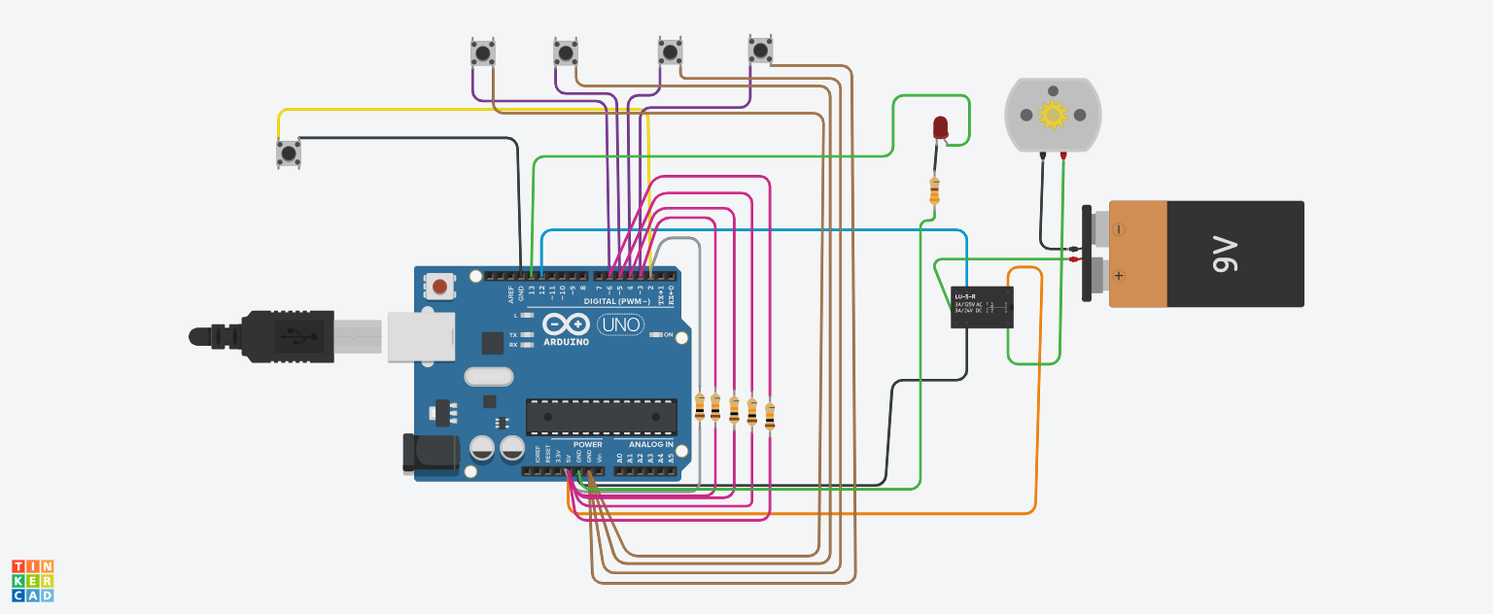
Implementation

Slide 9
Implementation
The implementation of the smart home automation system involves controlling two basic appliances, a light and a fan, using a simple interface with push buttons simulating voice commands and a clap button to toggle both devices. The core of the system is built on the Arduino platform, which utilizes various input pins connected to the buttons and output pins to control an LED (representing the light) and a relay (representing the fan).
Hardware Setup Component Breakdown:
Arduino UNO:
The central processing unit (CPU) of the system. Receives input signals from the push buttons.
Processes these signals to determine the desired action. Sends output signals to control the motor and bulb.
Push Buttons:
Two push buttons are used: one for controlling the motor and the other for the light bulb.
When pressed, they generate a digital signal (HIGH or LOW) that is read by the Arduino.

Slide 10
Implementation
Resistors (220 ohms):
Used as pull-up resistors for the push buttons. Ensure that the input pins on the Arduino are always defined (either HIGH or LOW) when the buttons are not pressed.
Motor (M):
An electromechanical device that converts electrical energy into mechanical energy.
Controlled by the Arduino to rotate in a specific direction or stop.
Light Bulb:
An electrical component that emits light when an electric current passes through it.
Power Supply:
Provides the necessary electrical power to the Arduino, motor, and light bulb.

Slide 11
Implementation
In this project I have replaced the sound sensors to detect the clap and voice commands with push buttons. One push button to control the commands of clap sound. 1st click on button(i.e, 1st clap) sends command as turn on loads 2nd click on pushbutton(i.e, 2nd clap) sends command as turn off the loads.And another of 4 push buttons are for voice commands, clicking on 1st button sends command light on, clicking on 2n button sends command light off, clicking on 3rd & 4th buttons sends command fan on & fan off.
Voice Light On: Turns the light on (button 1).
Voice Light Off: Turns the light off (button 2).
Voice Fan On: Turns the fan on (button 3).
Voice Fan Off: Turns the fan off (button 4).
Clap Button: Toggles both the light and fan simultaneously (button 5).

Slide 12
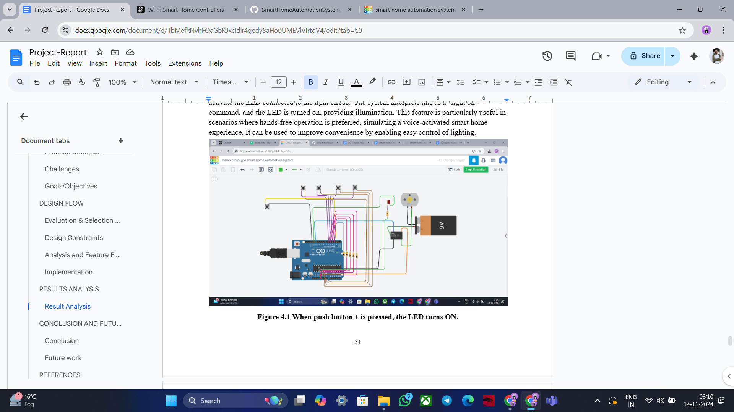
Results and Outputs
Case 1: When push button 1 is pressed, the LED turns ON

Slide 13
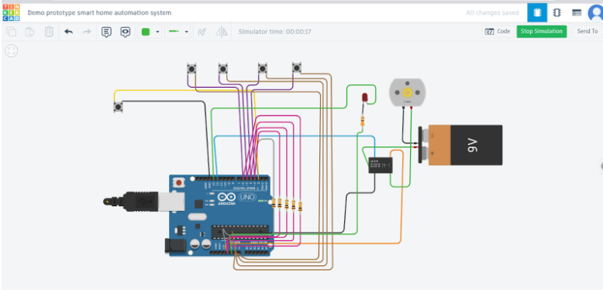
Results and Outputs
Case 2: When push button 2 is pressed, the LED turns OFF

Slide 14
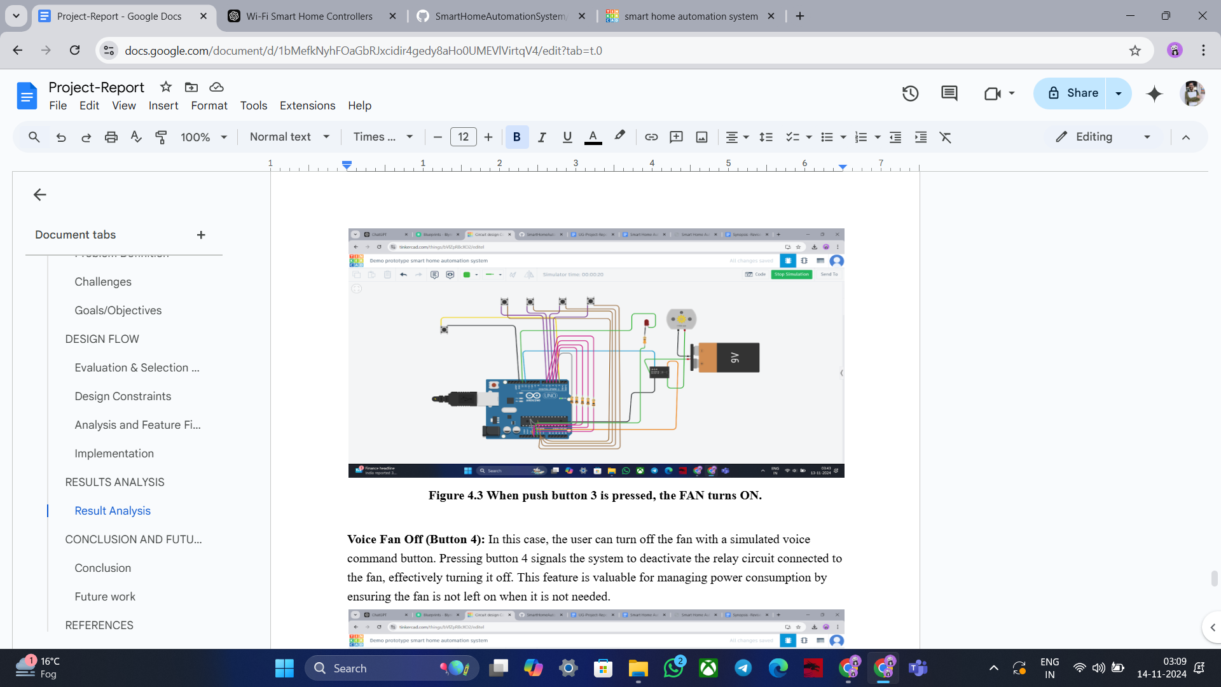
Results and Outputs
Case 3: When push button 3 is pressed, the FAN turns ON

Slide 15
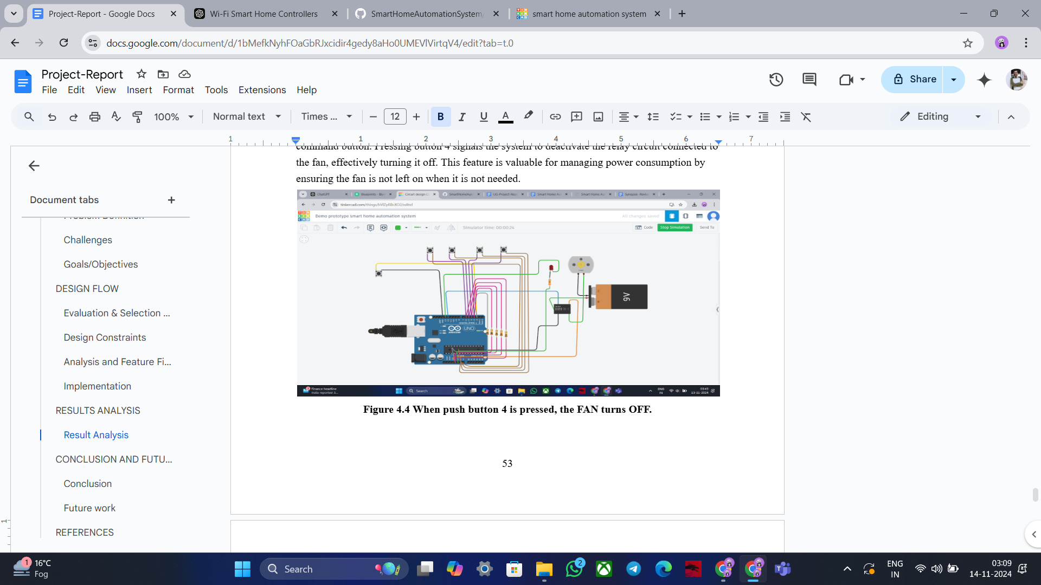
Results and Outputs
Case 4: When push button 4 is pressed, the FAN turns OFF

Slide 16
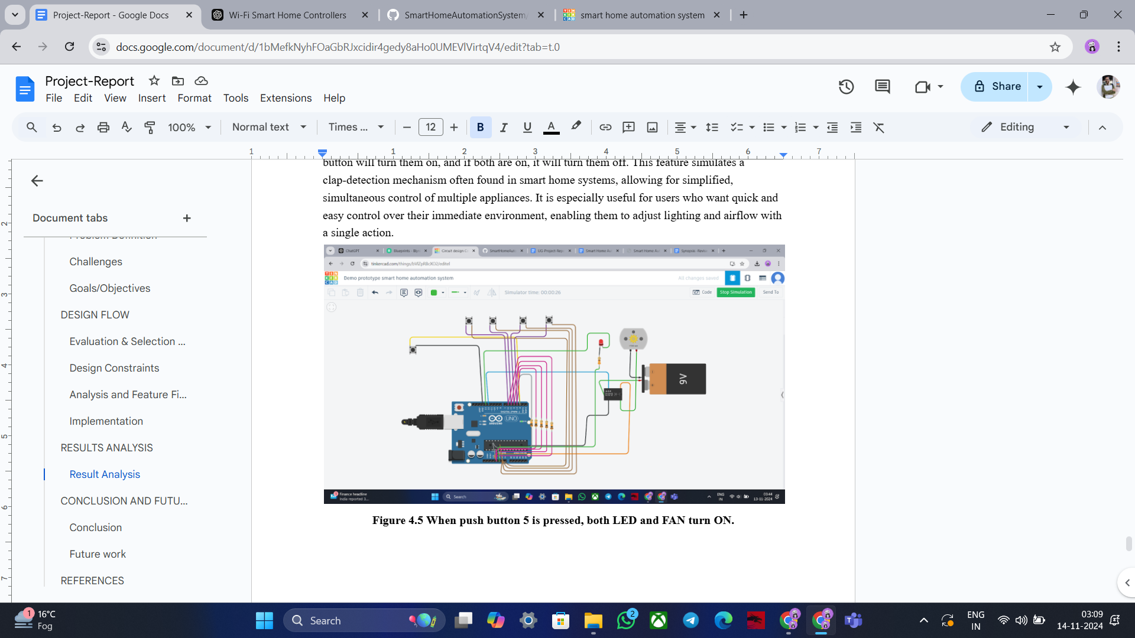
Results and Outputs
Case 5: When push button 5 is pressed, both LED and FAN turns ON

Slide 17
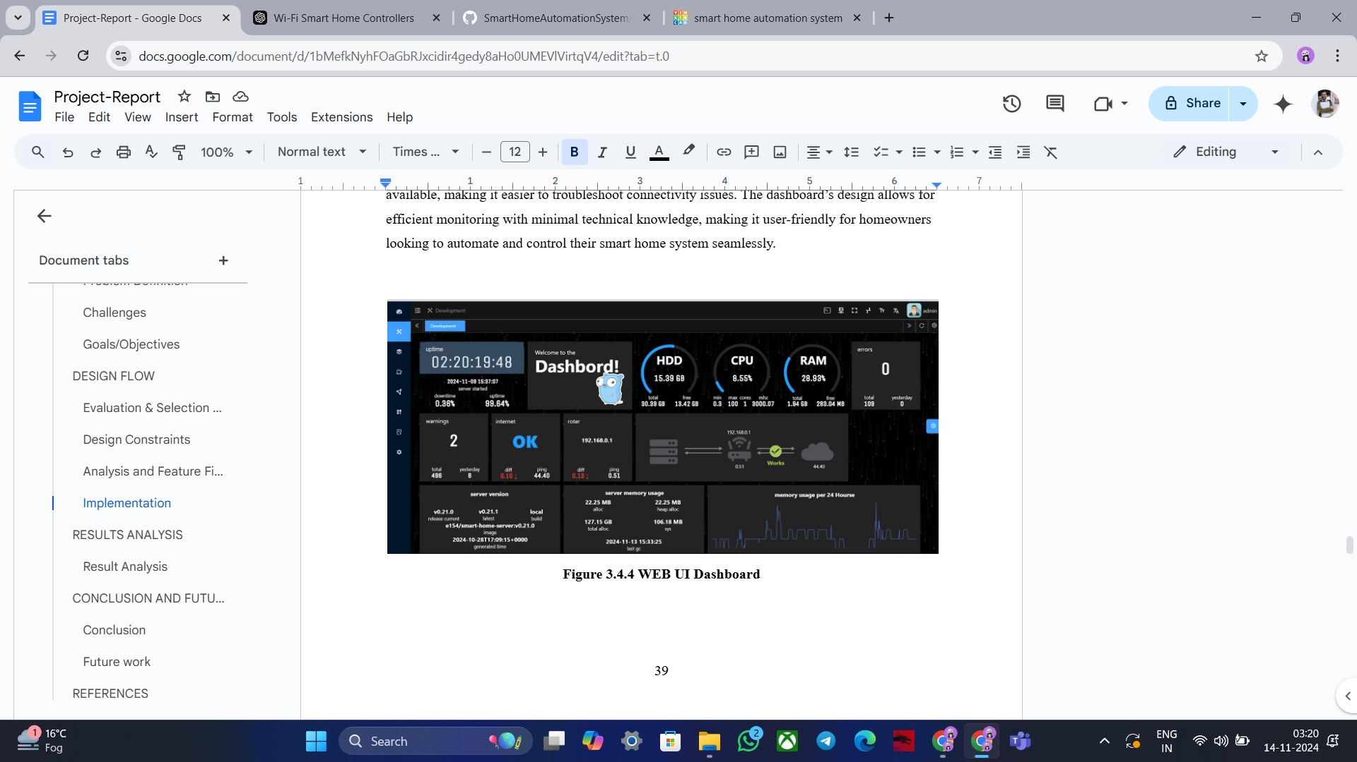
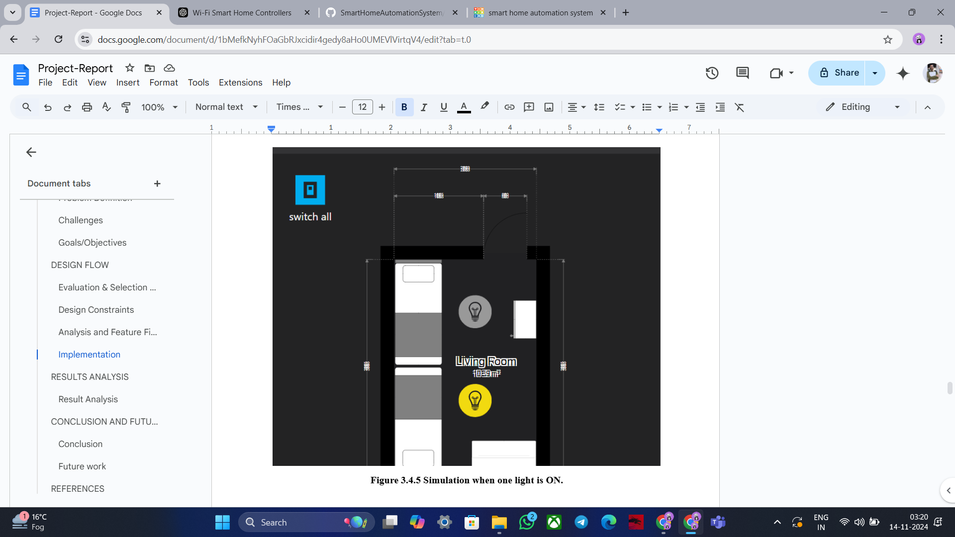
Results and Outputs
WEB UI Dashboard and Simulation

Slide 18
Conclusion
This research project has successfully demonstrated the transformative potential of smart home automation in revolutionizing domestic living. The developed system, through its effective integration of IoT devices, cloud technology, and a user-friendly interface, has showcased significant development opportunities in energy efficiency, convenience, and security. The findings of this study underscore the profound impact that smart home technology can have on residential environments. By automating tasks, optimizing energy consumption, and enhancing security, smart home automation can significantly improve the quality of life for homeowners. The system's ability to learn user preferences, adapt to changing conditions, and integrate with other home systems further highlights its potential to create a more personalized, efficient, and secure living experience.

Slide 19
Future Scope
The future scope of smart home automation systems lies in advancing interoperability standards, enhancing security protocols, and leveraging artificial intelligence to create more intuitive, energy-efficient, and user-friendly environments that integrate with emerging technologies and adapt to individual user preferences.
1. Enhanced integration:
We may anticipate increasing integration across various home systems as more smart gadgets become accessible. For instance, to maximize energy efficiency, a smart window system and thermostat may cooperate to modify natural light and temperature.
2. Improved AI capabilities:
Artificial intelligence developments will enable smart home automation systems to learn from and adjust to users' tastes and behaviors, increasing their usefulness and convenience. For instance, a smart house would be able to recognize when a person is coming home and adjust the temperature and lighting to suit their preferences.

Slide 20
Future Scope
3. More command with wearable technology:
With a few wrist taps, consumers will be able to operate their home from anywhere thanks to the increasing integration of smartwatches and other wearable technology into intelligent home automation systems.
4. A stronger focus on sustainability:
Sustainability and energy efficiency may become increasingly more important to smart home automation systems as concerns about climate change grow. For instance, energy storage and solar panels.
5. Greater focus on health and wellness:
With features like air purifiers and smart lights that change according to the time of day and users' activity levels, smart homes may become even more focused on enhancing users' health and wellness.

Slide 21
References
Froiz-Míguez I., Fernández-Caramés T.M., Fraga-Lamas P., Castedo L. Design, Implementation and Practical Evaluation of an IoT Home Automation System for Fog Computing Applications Based on MQTT and ZigBee-WiFi Sensor Nodes. Sensors. 2018;18:2660. doi: 10.3390/s18082660. [PMC free article] [PubMed] [CrossRef] [Google Scholar]
Gunputh S., Murdan A.P., Oree V. Design and implementation of a low-cost Arduino-based smart home system; Proceedings of the 2017 IEEE 9th International Conference on Communication Software and Networks (ICCSN); Guangzhou, China. 6–8 May 2017; pp. 1491–1495. [Google Scholar]
Ozeer U., Letondeur L., Ottogalli F.-G., Salaun G., Vincent J.-M. Designing and Implementing Resilient IoT Applications in the Fog: A Smart Home Use Case; Proceedings of the 2019 22nd Conference on Innovation in Clouds, Internet and Networks and Workshops (ICIN); Paris, France. 19–21 February 2019; pp. 230–232. [Google Scholar]
Perera, C., Zaslavsky, A., Christen, P., & Georgakopoulos, D. (2014). Context aware computing for the internet of things: A survey. IEEE Communications Surveys & Tutorials, 16(1), 414-454. doi:10.1109/SURV.2013.042913.00197
Spadacini M., Savazzi S., Nicoli M. Wireless home automation networks for indoor surveillance: Technologies and experiments. EURASIP J. Wirel. Commun. Netw. 2014;2014:6. doi: 10.1186/1687-1499-2014-6. [CrossRef] [Google Scholar]

Slide 22
References
6. Lee K.-M., Teng W.-G., Hou T.-W. Point-n-Press: An Intelligent Universal Remote Control System for Home Appliances. IEEE Trans. Autom. Sci. Eng. 2016;13:1308–1317. doi: 10.1109/TASE.2016.2539381. [CrossRef] [Google Scholar]
7. Puri V., Nayyar A. Real time smart home automation based on PIC microcontroller, Bluetooth and Android technology; Proceedings of the 3rd International Conference on Computing for Sustainable Global Development (INDIACom); New Delhi, India. 16–18 March 2016; pp. 1478–1484. [Google Scholar]
8. Baraka K., Ghobril M., Malek S., Kanj R., Kayssi A. Low Cost Arduino/Android-Based Energy-Efficient Home Automation System with Smart Task Scheduling; Proceedings of the 2013 5th International Conference on Computational Intelligence, Communication Systems and Networks; Madrid, Spain. 5–7 June 2013; pp. 296–301. [Google Scholar]
9. Zamora-Izquierdo M.A., Santa J., Gomez-Skarmeta A.F. An Integral and Networked Home Automation Solution for Indoor Ambient Intelligence. IEEE Pervasive Comput. 2010;9:66–77. doi: 10.1109/MPRV.2010.20. [CrossRef] [Google Scholar]
10. Aazam, M., & Huh, E. N. (2014). Cloud-based smart home automation system using fog computing. Proceedings of the International Conference on Ubiquitous and Future Networks (ICUFN), 1-5. doi:10.1109/ICUFN.2014.6890725

